Slide 1

Water Flow Diagram of ???
Area: ???
Population: ???
Inhabitants/km²: ???
Unit: 1’000 m³/year
Year: ???
Data sources: ???

Slide 2










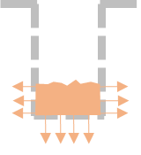


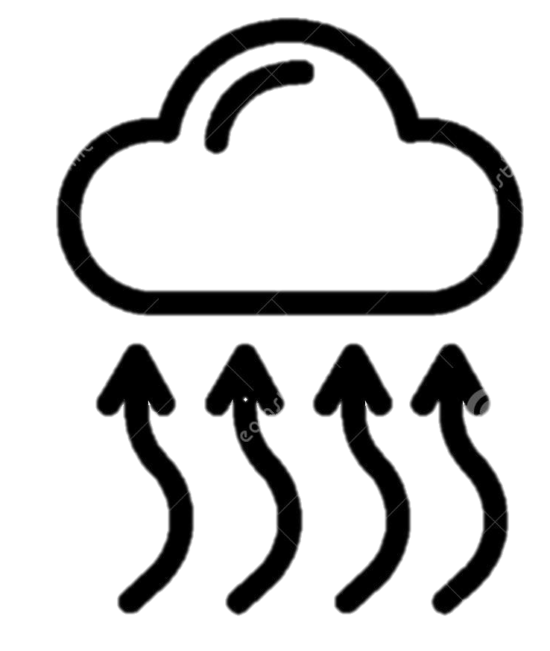

icons

Slide 3
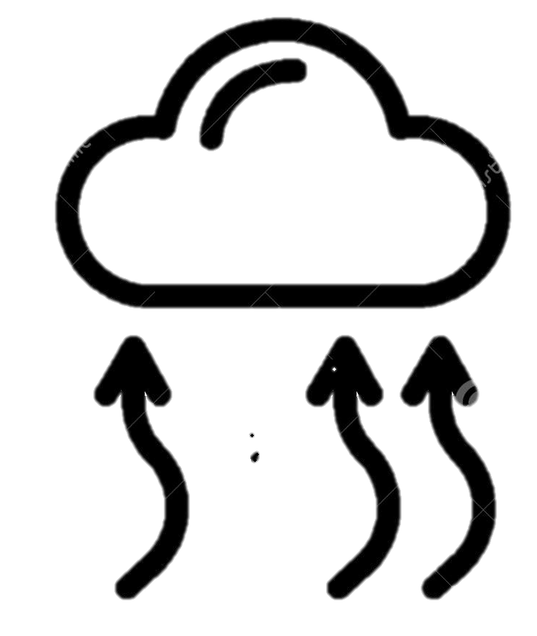

Slide 4
Optional: Renewable water resources
Precipitation
Renewable surface water
Renewable groundwater
Used water
1 mio m³/year

Slide 5
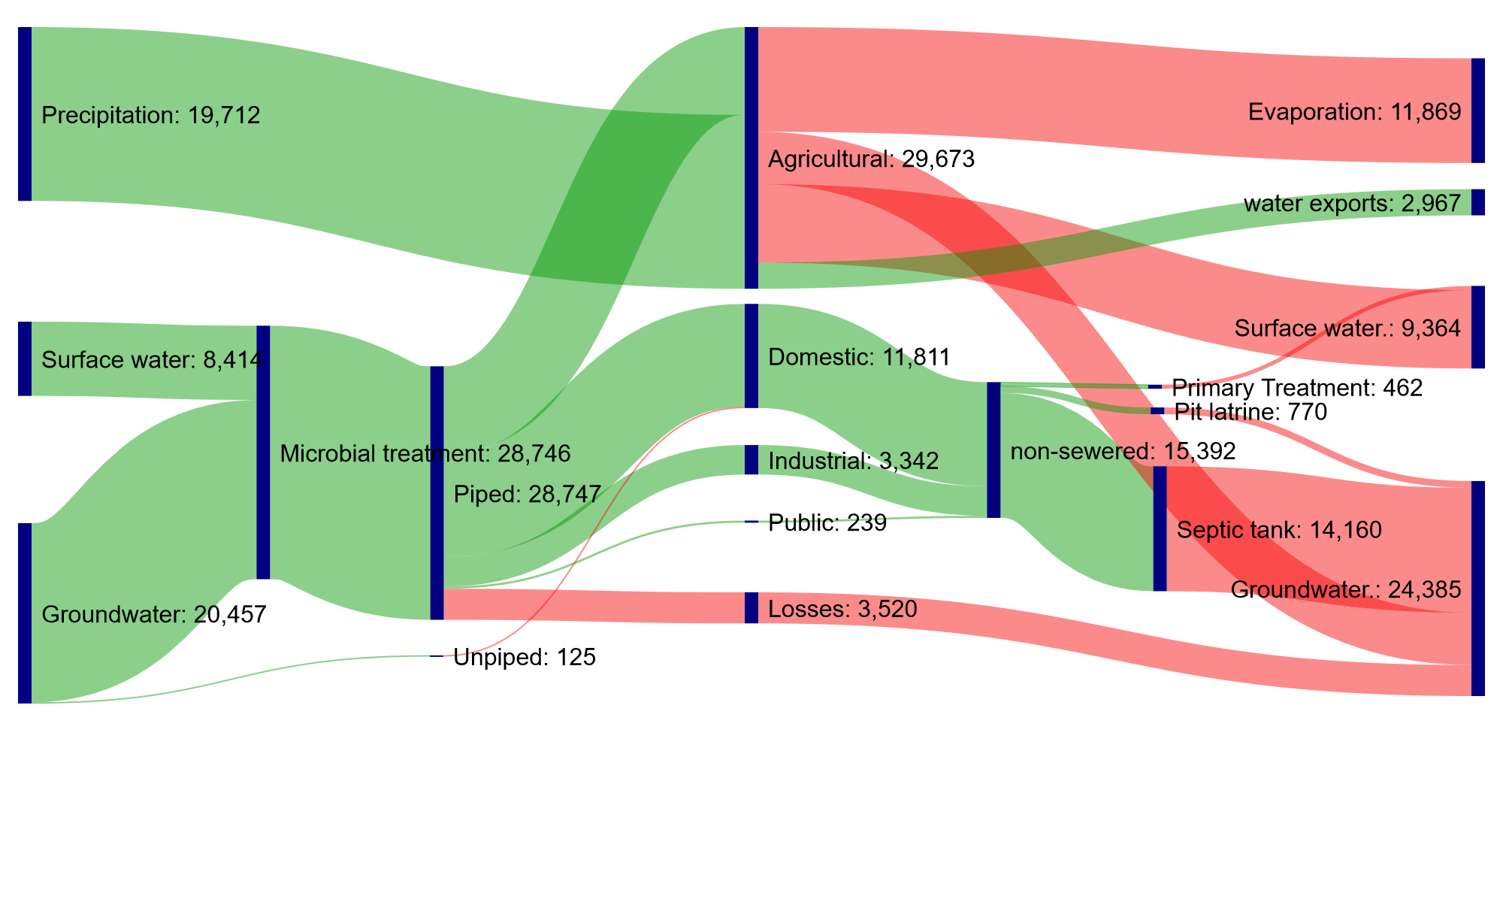

Area: 91km²
Population: 289,820 (2020)
Population density: 3,188 per km² (2020)
Connections: 51,450
Unit: 1,000m³
Period: 2022
Water Flow Diagram of Santa Maria, Bulacan
Precipitation
Renewable ground-/
surface water
Used water
1 million m³/year

